Slide 1
ACEs/PEARLs at
Peach Tree Healthcare
Meredith Evans, LMFT, Chief Behavioral Health Officer
Camesha Harper, LCSW, Behavioral Health Program Manager

Slide 2

Peach Tree Healthcare:
We are a Federally Qualified Health Center (FQHC). We serve 4 counties in Northern California; Sacramento County, Yuba County, Sutter County, and Butte County.
We see approximately 40,000 unique patients annually.
We provide Primary Care, Pediatrics, Women’s Health, Vision Services, Dental Services, Behavioral Health, Substance Use Treatment, Podiatry, & Acupuncture.

Slide 3

Behavioral Health at Peach Tree
Basics of our BH Program
Program Started in May of 2019. Since then, we’ve increased staffing and services for Peach patients.
11 Therapists at 7 locations (only 10 do ACEs)
2 PMHNP Providers via Telehealth
3 Behavioral Health Support Staff (Medical Assistants and BH Assistant)
1 Patient Navigator for entire organization
1 Patient Account Advocate
1 Behavioral Health Intake Coordinator
1 Complex Care Nurse Manager
1 Behavioral Health Program Manager
1 Chief Behavioral Health Officer

Slide 4

ACEs/PEARLs
Learning Pilot
In talking about strategic planning and goals for the fiscal year in 2020, Peach Behavioral Health decided to take on piloting ACES/PEARLS in our clinics.
We decided to make the goal to be 50% of new patients on the caseload for all full-time individual therapists at Peach Tree.
We made that decision in April 2020 and soft piloted in July 2020.

Slide 5

Barriers from pilot
Technology
Clinical
The ACEs screener tool that was on the ACES AWARE site was not the same ACEs screener tool that was in our EMR (NextGEN).
PEARLs wasn’t in our EMR, staff had to do it on paper.
Due to PEARLs being on paper, it has been a reporting/data collection pain point.
Patients only get 30 minutes for therapy, so the screener has to be the focus of an entire session and patients often don’t want to give up that time.
Medical staff aren’t really a part of the process at this time, unless they’re aware of ACEs/PEARLs (some of our Pediatricians are aware and appreciate the information).

Slide 6

COVID Impacts
POSITIVES:
We saw an increase of demand for Behavioral Health services
We were able to start providing virtual visits and telephone therapy to patients
We were able to reach patients who had never come into treatment because of transportation, child care, or work restrictions by offering telehealth.
NEGATIVES:
We had an increase in refusal to participate in ACEs (Patients were so overwhelmed with the pandemic, many stated that they didn’t want to discuss their past traumas because they felt like they were already dealing with too much).
We ran into barriers of youth patients being available, but their parents not being available when providing ACEs screenings over the phone/virtual visits.

Slide 7
Second Pilot (Prosody)
44%
Engagement
86% Completion
65% High Risk
Average Score
5 out of 10
We found ProsodyHealth for electronic outreach for screening via a HIPAA Compliant Software platform.
We engaged 562 adult patients via text message/emails through Prosody.
What we learned:
44% of adult patients engaged in the screener.
86% of those completed the screener.
65% were found to be a high risk
The average score was 5 out of 10.

Slide 8

What we learned with
PROS
CONS
Saved time for the clinician in session with the patient, because the patient score was already generated.
Gave the patient privacy to answer the questions and do it on “their time”.
When clinicians were able to do individualized assessment monitoring plans, it worked out easier.
TIME & COST.
Clinicians felt that there was not enough time to go back and put in patient information if it went out through Prosody in a bulk batching.
The cost of the service couldn’t be offset, because DHCS and Medicare did not allow for anyone other than a licensed practitioner reviewing the score with the patient. Large batches of assessments were too burdensome for staff.
Clinician had to jump between EMR and Prosody platform, adding time to the visit, which we don’t have.

Slide 9
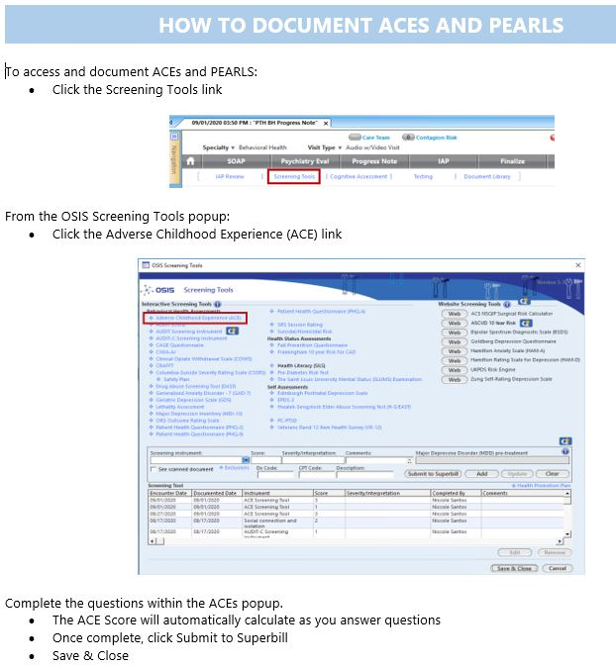
ACEs at Peach NOW:
Our Behavioral Health Coordinator calls the patient before their first visit, explains the need for the ACEs screener, provides general information on toxic stress, and connects the patient to our Navigator if they need resources due to their score.
The Coordinator then writes a note in the chart with the patient’s ACEs score and outcome of discussion for the therapist to have information on the first visit. The therapist then bills for the service after discussing the results with the patient.
We also do ACEs/PEARLs screeners at HELP ME GROW events for First 5 in Sutter County. This is used a mental health development milestone tool to help parents navigate resources and needs.

Slide 10
Current ACEs Workflow:
BH Intake Coordinator completes the ACEs screener with the patient
BH Coordinator documents score in the EMR, writes note with what information was given to patient.
Resources are given to patient and first appointment is scheduled with therapist.
Therapist goes over screening tool results with patient and documents/bills for the screening.

Slide 11

Future of ACEs at Peach:
We’re hoping to integrate ACEs screenings on the medical side of the house, as part of the reason for a referral to behavioral health services.
Our hope is to work with Prosody Health again in the future to send out assessments to patients via text message, because we found it to helpful for our population.

Slide 12


What we are Learning:
If the screening tool is not directly in the EMR, staff are less likely to complete it.
Have patience. You’ll be relying on others in various departments.
Find champions. We’ve found two medical providers that WANT to incorporate ACEs and will be involved in our organizational effort to make ACEs/PEARLs understood & incorporated by our medical providers.
The tool seems somewhat redundant for Behavioral Health staff, as many of the questions/discussion topics are completed as part of the psychosocial intake.
Join your local ACEs communities online - https://www.acesconnection.com/

Slide 13
Why Screen For ACEs In Primary Care
Screening tools can be used to provide targeted clinical interventions and equitable health care.
Adults
Can validate and empower patients to actively participate in their health care and treatment plans
Can improve clinical outcomes and treatment planning for chronic conditions
Can facilitate educational opportunities for patients to understand the connection between childhood adverse experiences, toxic stress, and medical outcomes
Children and Adolescents
Routine screenings for children and adolescents increases opportunities for early detection and increases opportunities for early prevention.
ACEs screenings can prevent and reduce adversities that could lead to negative health outcomes.
Screenings improve clinical outcomes and assessments and can improve treatment for childhood heath conditions.
Source: acesaware.org

Slide 14

Facilitating the Conversation
Take time to explain the ACEs screener, the length of time that the screener will take, number of questions on the screener, and meaning of Adverse Childhood Experience.
Prepare the patient by explaining that some questions may be difficult to answer
Allow the patient the autonomy to decide if they prefer to complete the screener alone or with guided assistance
Understand and accept that not all patients are comfortable or willing to complete the screener.
Take time to review the ACEs screener results with the patient
Validate concerns and answer questions
Aske permission if offering resources or connection to Behavioral Health Services
This Photo by Unknown Author is licensed under CC BY-SA

Slide 15
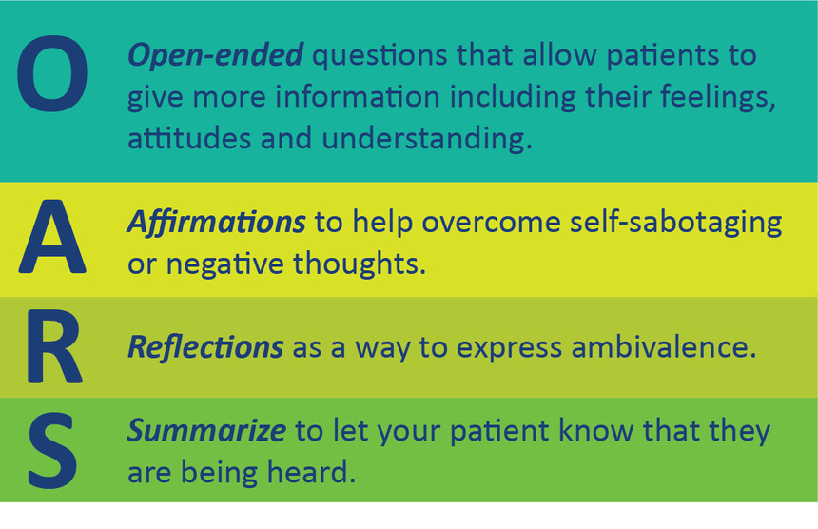
Motivational Interviewing

Slide 16
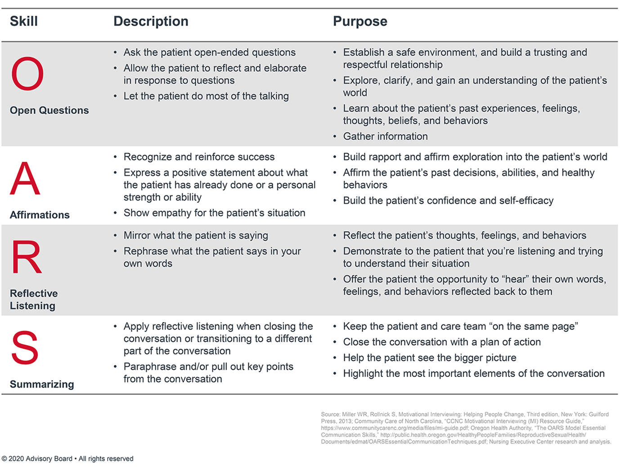

Slide 17

Conversation Starters
It is natural to feel stress, anxiety, grief, and worry during traumatic events. Is it okay if we talk about the questions that you answered yes too?
After a traumatic event, people may have strong and lingering reactions. How does your family manage stress?
Has stress ever impacted your mental or physical health, if so how?
How do you manage your day-to-day stress?
This Photo by Unknown Author is licensed under CC BY-SA-NC

Slide 18

What do you need to know as medical providers?

Slide 19

Questions?

Slide 20


Contact Information
Email Us
Meredith:
Meredith.Evans@pickpeach.org
Camesha:
Charper@pickpeach.org

